Slide 2
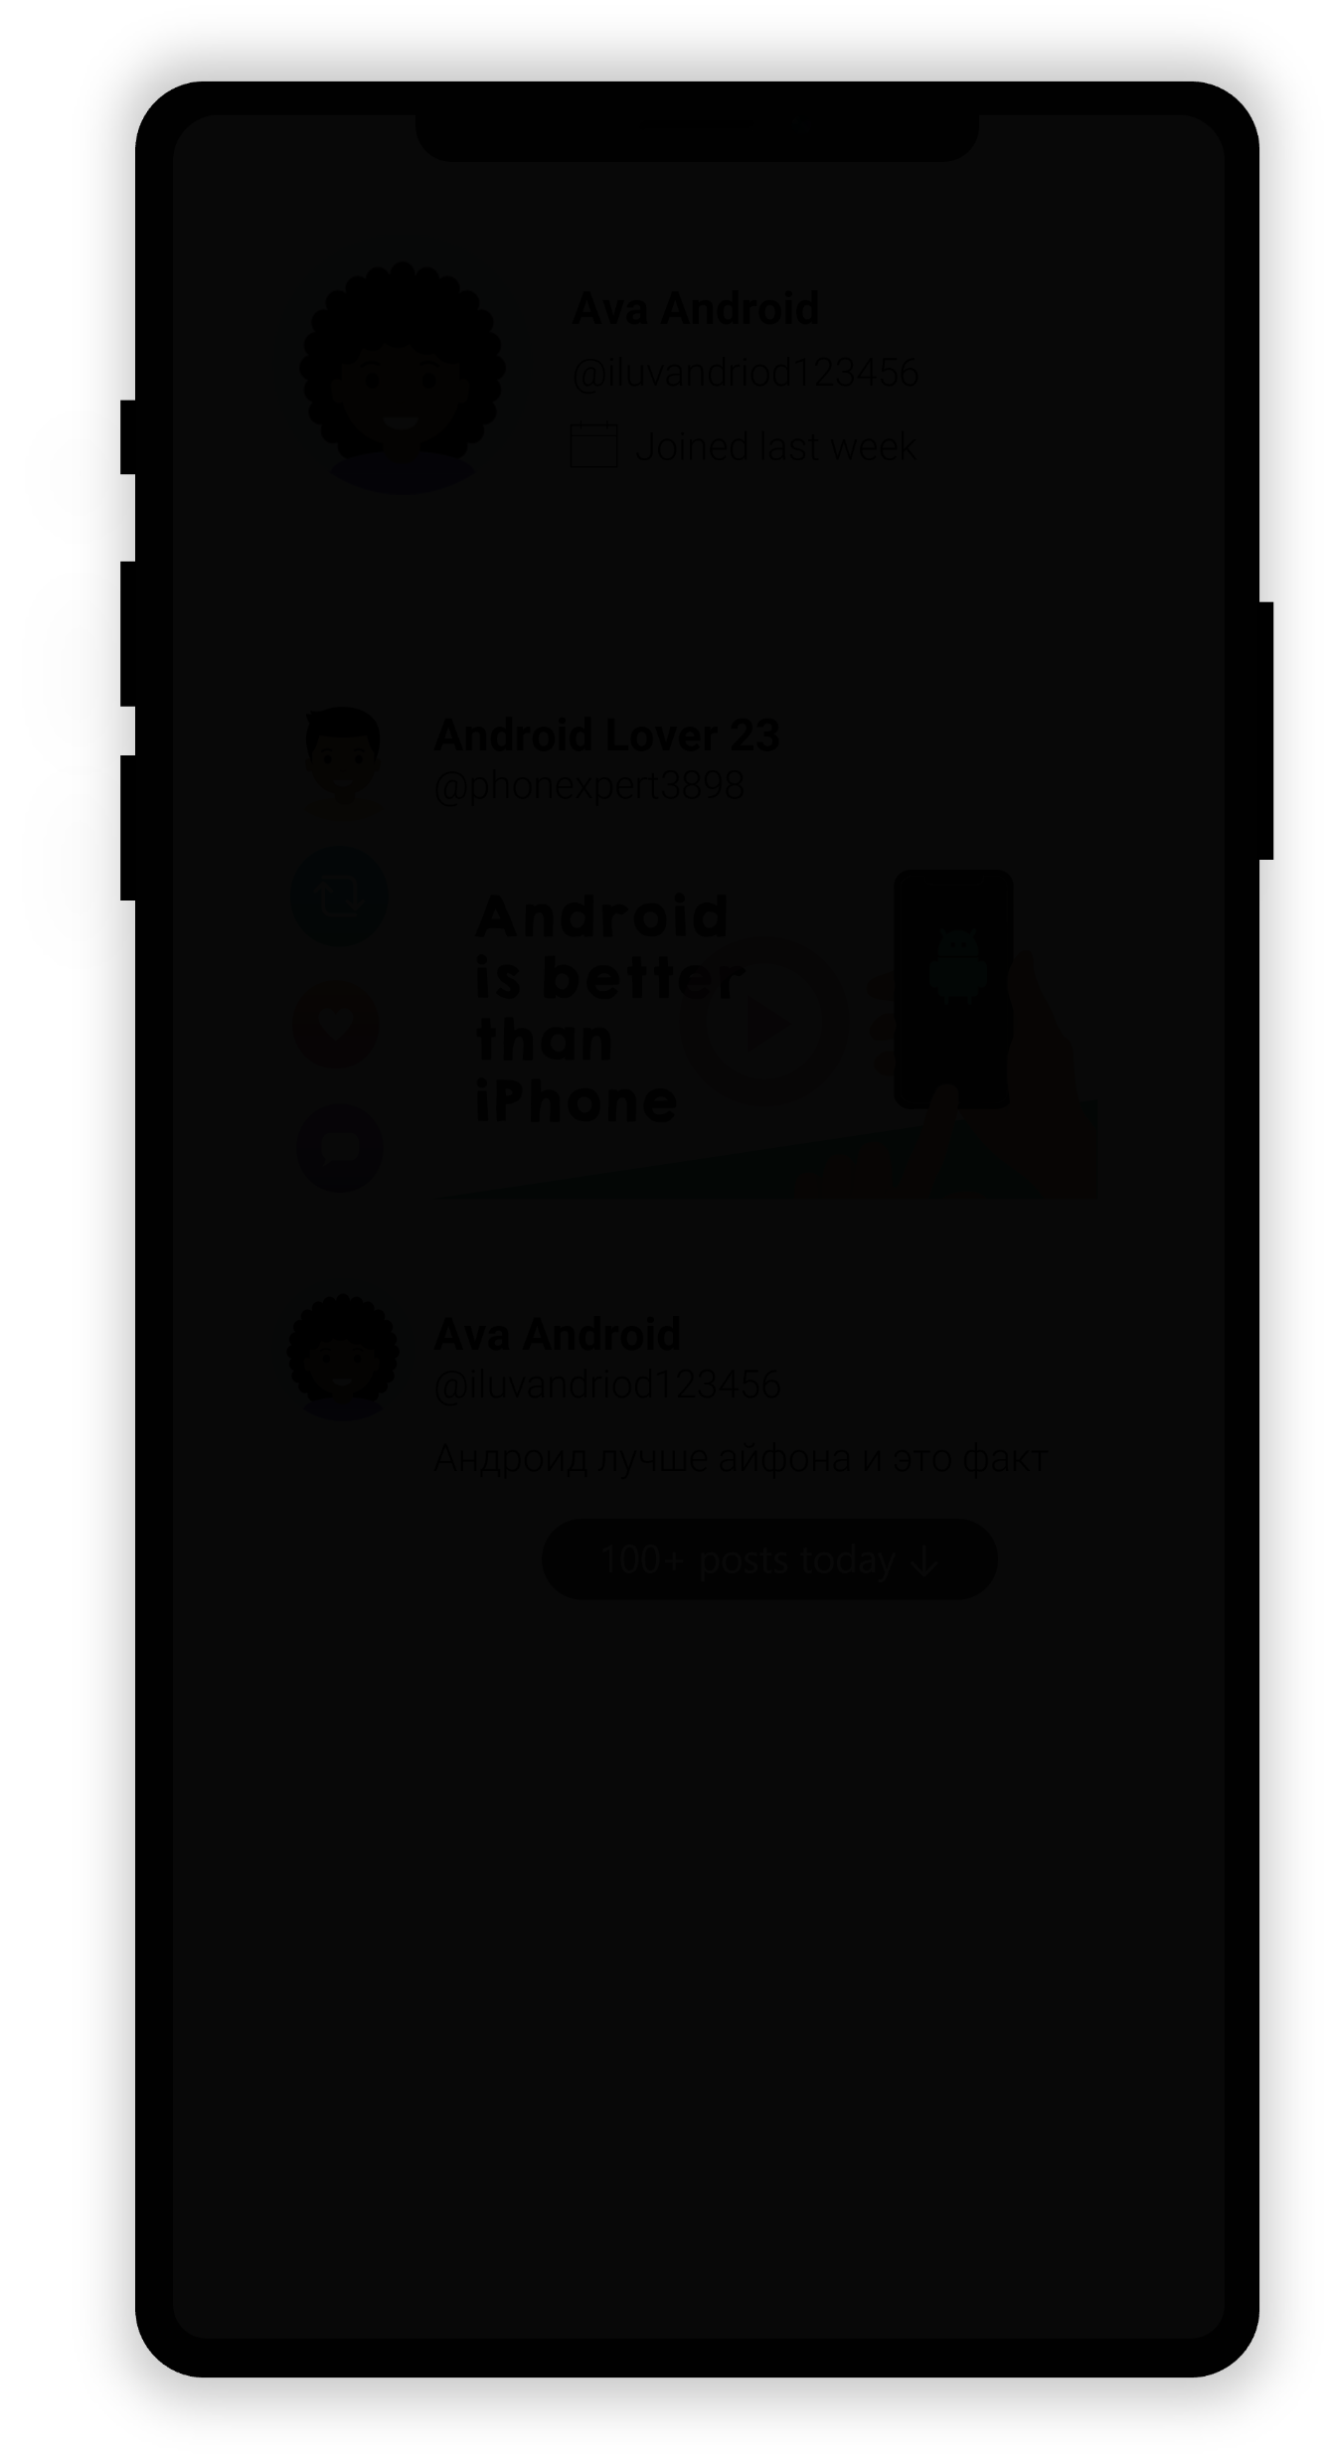
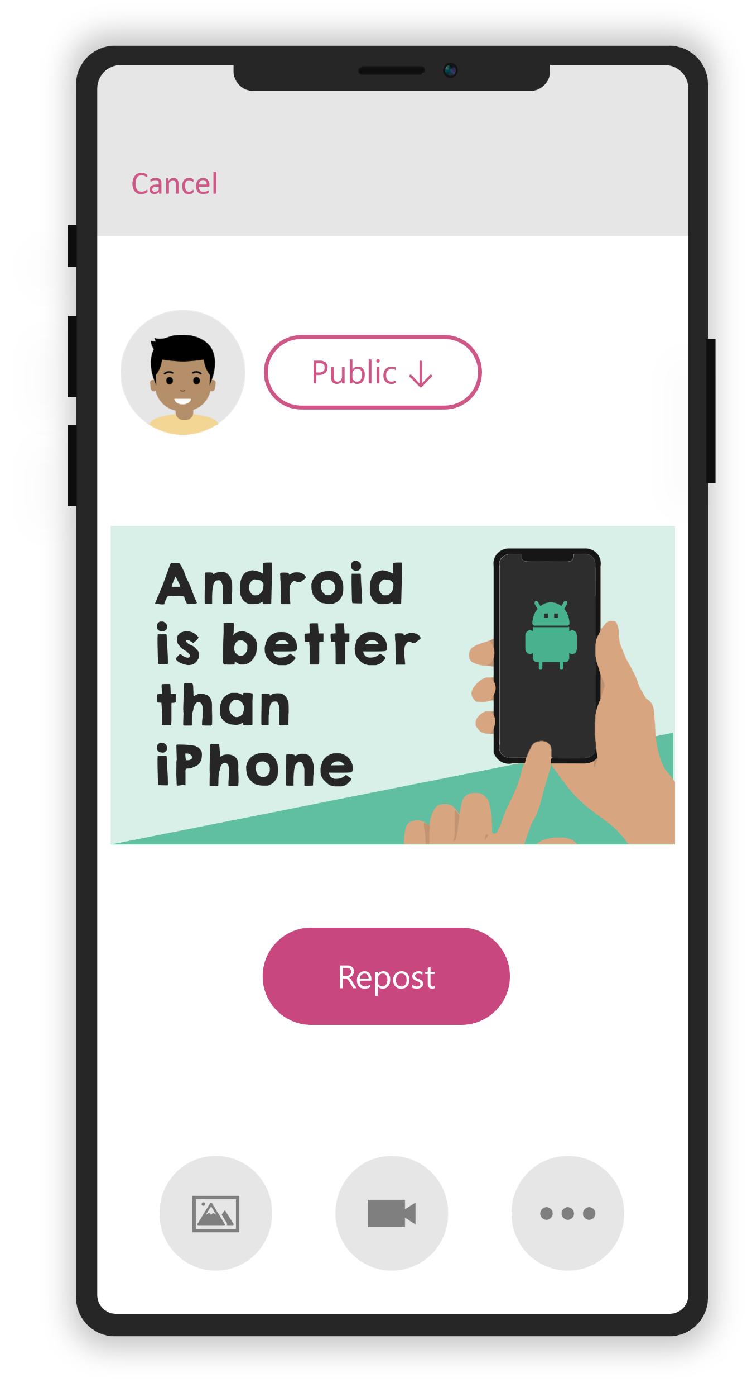




Slide 3

Ahhh, a human! Looks like your company caught on to my harmful social media bot antics. They call me fake, but I was just trying to make some cache cash...
Chat Like A Human 101

Slide 4
Now, I realize I had a chip on my shoulder. I'm ready to switch gears and become a helpful bot. I’ll prove it by showing you how to spot the bad bots online.
Chat Like A Human 101

Slide 5



Slide 6
1
2
3
4
5
1

Slide 7








Profile
Posts
Replies
Ava Android reposted this
2m ago
Ava Android commented on this
Android Lover 23
@phonexpert3898
Steven Shaw
@stevenshaw
Website: We use cookies to improve performance.
Me: Same
Ava Android
45m ago
@iluvandriod1496
#androidforlife 📱🤙🎉
Check out my website
Android is better than iPhone
Joined last week
8
14
2
1,298 Following
30m ago
Ava Android
@iluvandriod1496
Claim your free phone! 📱
Congrats, @stevenshaw! You just won a free android phone. To accept your gift, all you have to do is click this link. #androidwinner #freeandroid
7 Followers
27
3
25
Ad
Learn the Robot Dance
Ava Android
@iluvandriod1496
Андроид лучше айфона и это факт
#androidforlife
3m ago
Call 1-800-Beep
100+ posts today ↓
34
1
32
7
0
5

Slide 8






8:32
Tami Boyle
@tamib23
Joined 5 days ago
23 Following
11 Followers
Posts
Tami Boyle
@tamib23
I just finished creating my
first presentation using @company. 😄
3d ago
3
1
0
Tami Boyle
@tamib23
Just set up my account!
5d ago

Slide 9




8:34
John Johnson
@mr-john.johnson
💰 I teach people how to make passive income. #makemoney. ⬅️
Joined 2 weeks ago
1,733 Following
4 Followers
Replies
Company
@company
We’re hiring! Browse our current job openings here!
5m ago
18
4
3
John Johnson
@mr-john.johnson
Didn’t work. Click here to see.📲 #makemoney
5m ago
0
0
0

Slide 10

8:36
Bernell Evans
@bernell90876
Joined 1 year ago
1,482 Following
1,456 Followers
Posts
1m ago
Bernell Evans
@bernell90876
@company has bad customer service.
25
0
28
Bernell Evans
@bernell90876
Want business you can trust don’t hire @company.
1m ago
100+ posts today ↓

Slide 11
#1 Human

