Slide 1

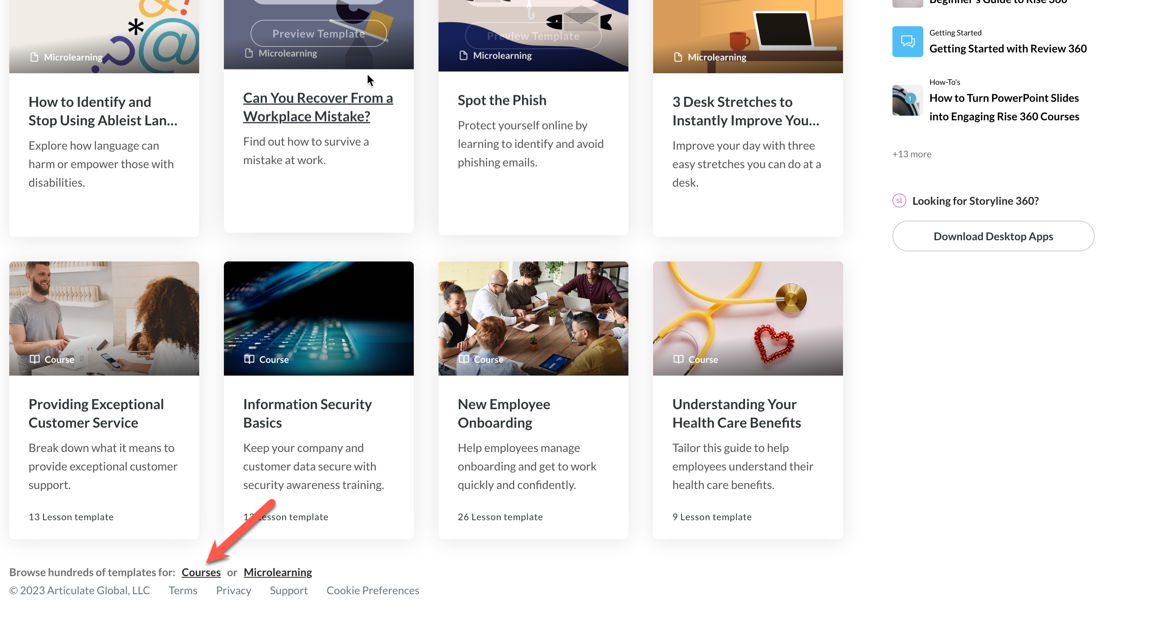

Slide 2
Flipped text box test

Slide 3


