Slide 1
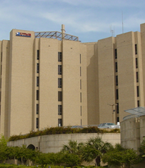
Security Awareness
In Offender Patient Care
Copyright © 2021 The University of Texas Medical Branch
All rights reserved. Reproduction or transmission of any part of this work
without the prior written consent of UTMB is strictly prohibited.
Updated 2021
Charlene Nieten RN MSN CCRN
Clinical Nurse Educator

Slide 2
Course Overview
The Security Awareness course will educate employees about policies and procedures of working with offender patients, an overview of offender patient care, requirements of a correctional environment and prohibited items in a correctional facility.
This course is intended for employees assigned in the Texas Department of Criminal Justice Hospital (TDCJ), members of the UTMB medical team, employees requesting TDCJ security clearance or have the potential for offender interaction.
Both Hospital and TDCJ Management are dedicated to providing a safe environment for staff to work. Each person completing the Security Awareness course will be better prepared to work in a maximum-security hospital and care for an offender patient regardless of their location on campus. This should achieve a safer workplace for all.
Approximate time to complete this course is one hour.
Presented by
The University of Texas Medical Branch
Texas Department of Criminal Justice Hospital
301 University Boulevard
Galveston, Texas 77555
https://hr.utmb.edu/tod/elm/
Course Sponsor: Charlene Nieten

Slide 3
Introduction
The TDCJ (Texas Department of Criminal Justice) Hospital, also known as Hospital Galveston, is a unique facility. It is the only maximum-security hospital facility expressly designed for offender care on a medical center campus.
The two state agencies, UTMB and the TDCJ Hospital, maintain a distinctive partnership.
The primary goal of Hospital Galveston is to deliver high quality medical care in a safe and secure environment. This goal is accomplished by the presence of security officers and by the responsible awareness of each staff member.
UTMB Healthcare workers may be required to care for patients who are prisoners from a variety of institutions, such as Texas Youth Commission (excluding Galveston Campus), County and City Jails, as well as Federal Prisons.
Agency policies may vary, but the information in this course will apply to most interactions you will have with an incarcerated patient.

Slide 4
Course Structure
Employee Requirements
Weapons and Special Requirements
Patient Care
Suicide Code Procedures and Prevention

Slide 5
Employee requirements
By the end of this section, you will gain an understanding of:
  Required identification procedures
  Searches
  Dress code policies
  Hostage policy and procedures

Slide 6
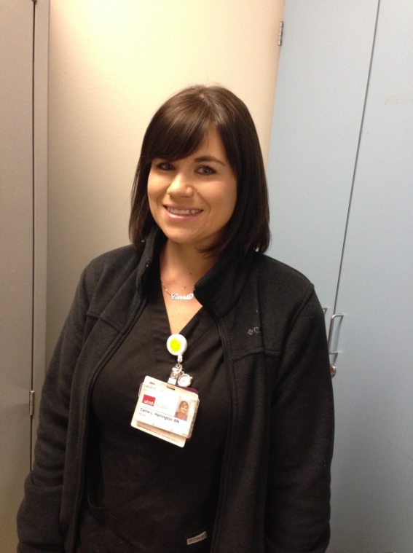
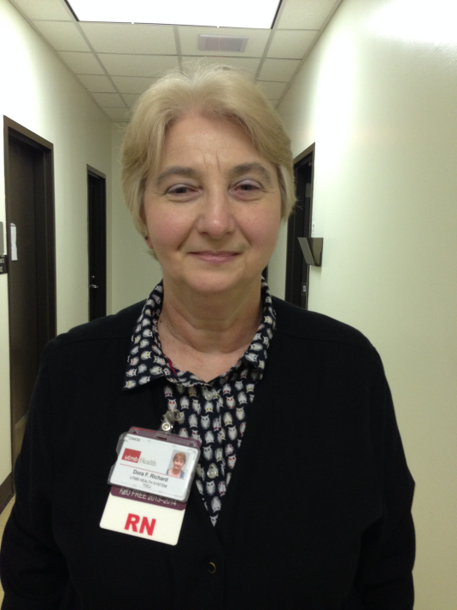
Identification Badge Requirements
While in the TDCJ Hospital, you must visibly always wear your ID badge.
NOTE: A valid Texas driver’s license may be presented as ID only for 72 hours. Borrowing someone else’s ID badge to gain access or to depart from the TDCJ Hospital is a violation of UTMB and TDCJ policy and may result in the loss of your security clearance.

Slide 7
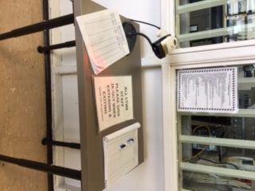
Entry and Exit Identification Points
Upon entering or exiting Hospital Galveston, you are required to present your ID Badge at the Security points each and every time. There are NO Exceptions.
You must place your ID badge in the window for the corrections officer to view each time you enter or exit the facility. Failure to present ID can result in denial of access to Hospital Galveston.
A search of belongings may be required upon entering facility.
Barcodes are available for long term security clearance.
Appropriate dress code shall be reviewed at TDCJ discretion.

Slide 8
Barcode Information
After security clearance, obtain a barcode for scanning in and out from nursing administration on the second floor
If you do not have clearance, contact 2nd floor of TDCJ hospital administration to file proper paperwork.

Slide 9

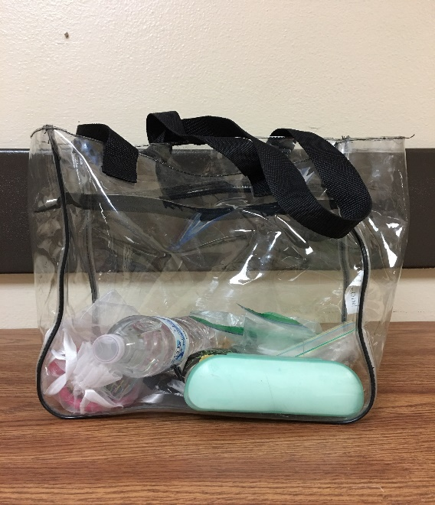
Searches
All bags brought into Hospital Galveston are subject to search by a correctional officer at all entry points. The following items are recommended in order to ease the search:
One gallon zip lock bag
OR
Clear plastic handbags not to exceed 1 gallon in size
Only items which are essential for the performance of your job should be brought into Hospital Galveston unless authorized/approved by Warden or designee.

Slide 10

Dress Code expectations
  Dress should be professional
  NOT ALLOWED:
  Shorts
  Skirts and dresses above the knee
  Transparent or translucent blouse
  Low cut blouses, tops, or scrubs
  Sleeveless shirts, blouses, or dresses
  Tight clothing
  All white

Slide 11

Unauthorized items
Weapons:
Guns, knives, mace, knuckles
Cell phones
Smart watches
Recorders
cameras
Alcoholic beverages
Illegal drugs
Prescriptions (except opioids and benzodiazepines) allowed if in original container with doses needed for for the day
Notes:
Basically if not on the list just do not bring it

Slide 12

authorized items
List of Approved Items
Please click the link above for a complete list of items allowed to be brought in with you and print to refererence

Slide 13
Items Used to Make Weapons
Tape
Tongue Blade
Pens
Flammable Liquid
Safety Pins
Disposable Razor Blades
IV Tubing
Paper Clips
Scissors
Pencils
Needles
Aerosol Spray
Safety Pins
In addition to conventional weapons, there are many everyday items that can be used to create weapons. As an employee you must be aware of the items listed and remain alert to the fact that these items can be used to make all types of weapons.
ANYTHING brought into TDCJ can be fashioned into a weapon.
Remember, your responsible awareness of the proper disposal and removal of such everyday items from an offender patient’s room helps keep everyone safe.

Slide 14
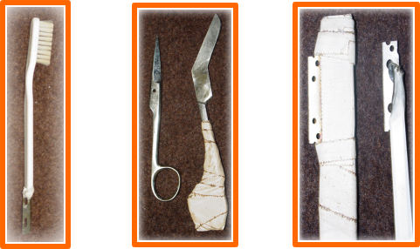
Items Used to Make Weapons
The following are some examples of weapons that have been made from the items listed on the previous page
Scissors
Medical Tape
Toothbrush
Tape
Razor
Medical Tape
Tongue Blade
Razor

Slide 15
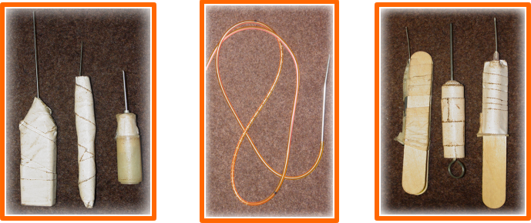
Items Used to Make Weapons
Tongue Depressors
Medical Tape
Needles
Dobhoff Feeding Tube
Medical Tape
Needles

Slide 16
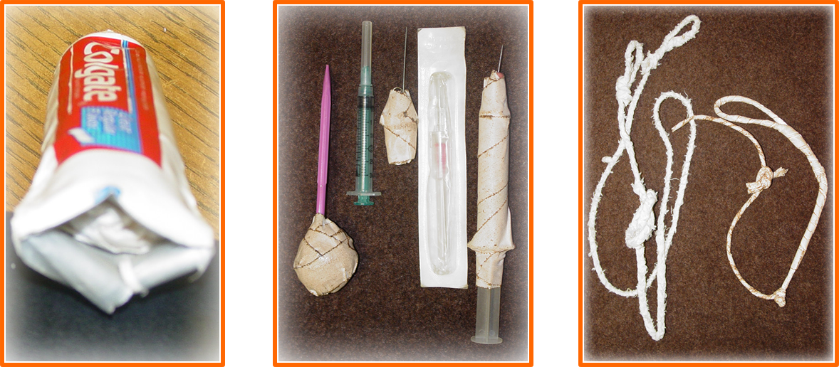
Items Used to Make Weapons
Empty Tube of Toothpaste
(used to hide contraband)
They can be hidden anywhere on the offender including in the stitching of their clothing and orifices.
Hypodermic Needles
Medical Tape
Syringes

Slide 17
Hostage Policy & Procedure
In accordance with UTMB Health Institutional Handbook of Operating Procedures (IHOP) Policy 8.2.6 Hostage Policy Involving Offenders/Correctional Patients & related IHOP Policy 8.2.7 Security Associated with Offender Correctional Patients, TDCJ employees will not permit offenders to use hostages to escape custody or otherwise interfere with orderly institutional operations or be recognized for bargaining purposes.
THIS MEANS LEAVE THE ROOM IMMEDIATELY IF YOU FEEL EVEN THE SLIGHTEST BIT UNCOMFORTABLE WITH THE OFFENDER’S BEHAVIOR.
If you are held hostage, don’t:
Be hostile – complain, be sarcastic, or criticize the hostage taker
Be a hero
Plant ideas – worry out loud, give suggestions
Moralize or threaten
Be obnoxious – chatter, joke, cry, lose control of bodily functions

Slide 18
Removal and disposal
Proper removal and disposal of items used to make weapons is important for everyone’s safety. As an employee it is your responsibility to ensure proper disposal and removal of these items.
In accordance with UTMB IHOP Policy #8.2.7 Security Associated with Offender/Correctional Patients. The following guidelines should be followed:
    Equipment or supplies not routinely used or medically necessary in the delivery of patient care should not be left in the offender’s room without the approval of TDCJ security.
    Any equipment that is left in the patient’s room will be checked for any missing parts (e.g., knobs, wires, etc.) before it is placed in the room, during use, and prior to leaving the room. Any missing items will be reported to TDCJ security immediately.
    All sharps should be disposed of in proper containers only.

Slide 19
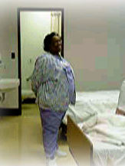
Patient Interaction
In order to maintain a professional environment, for your safety, and the safety of others, there are specific rules to follow while interacting or having a conversation with a patient.
When interacting with an offender patient, your conversation should be limited to the purpose of the visit and medical care.
You should introduce yourself by your title with either your first or last name such as Nurse Nieten, Nurse Charlene – NO NICKNAMES
DO NOT SHARE PERSONAL INFORMATION SUCH AS WHERE YOU LIVE, HOBBIES, FAMILY, ETC.

Slide 20
Patient Non-Healthcare Needs & Disruptive Behavior
If a patient’s behavior is disruptive or agitated, health care staff should make every attempt to de-escalate the situation if appropriate. When all attempts have failed and security is needed, nursing staff are advised to leave the room and ask for security assistance.
All patient non-healthcare needs are handled by TDCJ security personnel for example:
  Letters from offenders (Do not accept from an offender. Request the officer come and handle the letter)
  Religion
  Mail, Reading, and writing materials (exception is education sheets related to offender’s medical care)
  Family contact
  Telephone calls unless providing information to known healthcare provider

Slide 21
Patient Information / Communicaton
When handling communications, external or internal, to an offender patient there are a few rules to remember.
All external calls regarding the patient must be channeled through TDCJ Security.
Families can call “Family call line” at 409-772-6131 and leave a message for updates.
Providing information about a patient over the telephone is prohibited except Physicians and Nurse practitioners – they are permitted to update family members who are on a preapproved list provided by patient
Providing information about the exact date, time, or location of an admission or appointment is prohibited including when they are going to surgery while inpatient.
Direct all inquiries to (409) 772-6106 or (409) 772-6108

Slide 22
Security levels
Determines the requirements necessary for interacting with offender patients
White – GP (General Population
Level 1-Level 4
Door unlocked if progressive care
Green/Orange - AD SEG
Door locked, 2 officer presence in the room
Yellow – Death Row
Door locked; two officers must be present in the room at all times with a TDCJ supervisor.
Salmon – G5
Door locked, officer presence in the room
Due to available stock of colored paper, this may not be consistent. At times high security offenders may have all salmon or all yellow tags. Sometimes the paper is white and is highlighted to communicate high security information. Just remember to read the paper and security level.

Slide 23
Entering and Leaving the Patient’s Room
Prior to entering room – lights on!
Door open while in room at all times except airborne and extended respiratory isolation
Patient should be in bed or sitting in a chair
Behavior that is disruptive or patient is agitated is reported to the security officers – leave immediately
Supplies – whatever you bring in make sure you bring it back out with you
Curtains remain open unless in use for privacy with the officer present. Patient is not allowed to draw curtain. Leave immediately if the patient draws the curtain and alert officer!

Slide 24
Part 2: suicide code procedures and prevention
Most common cause of death in correctional setting
Hanging or Overdose
Factors that influence suicide rates:
  Mental illness, especially mania and depression
  Impulsivity
  Sense of failure and hopelessness
  Feelings of guilt and/or shame related to crime
  Recent suicidal ideation
  History of attempted suicide
  Having a current psychiatric diagnosis
  Single cell occupancy
  Relationship issues
  Other personal stressors prior to or while incarcerated
Choi, N. G., DiNitto, D. M., & Marti, C. N. (2019). Suicide Decedents in Correctional Settings: Mental Health Treatment for Suicidal Ideation, Plans, and/or Attempts. Journal of Correctional Health Care, 25(1), 70–83. Retrieved from journals.sagepub.com/home/jcx

Slide 25
Suicide observations
Higher risk of suicide in patients with prior suicidal behavior
Completion of suicide greater in mental health patients
Pay attention to:
  Change in mood or behavior like crying with routine patient rounding
  Patient’s conservation close to court hearings i.e. feelings of hopelessness
  Visits with family/friends that escalate into disputes
  New diagnosis/poor prognosis

Slide 26
Suicide Code Tips
When a patient is attempting/committing suicide in a locked room:
  First tell the patient to stop. Sometimes it is an attempt to lure someone inside the room and not a true suicide attempt
  Notify an officer immediately.
  The officer will call for a supervisor, initiate incident command system (ICS) and “A” responders will be deployed.
THE NURSE AND ALL MEDICAL STAFF DO NOT ENTER UNTIL THE SCENE IS DEEMED SAFE BY THE OFFICER

Slide 27
Suicide code tips
  Call rapid response team or Code blue @ 24000 and 26108 to inform security of emergency and any other needed supplies. This communication will also increase the speed at which the emergency/rapid response team are able to respond.
  The officer may pepper spray the patient to chemically control the patient if the patient is in the physical act of hanging themselves and their feet are touching the ground.
  However, if the patient is touching the ground but not conscious, no pepper spray will be used.
    The purpose of the pepper spray is to stop the patient in the act and to keep staff safe.
TIP: Keep an extra face mask in your pocket for the possibility of being exposed to a chemically sprayed agent when assigned to high-risk suicide patients.

Slide 28
Suicide code tips
The officer will call the suicide code over the incident command system and the picket will open the gate for officers to respond to the scene with help and an emergency response kit.
The emergency kit includes a one-way valve mask, 911 tool (tool to cut litager), purell packets, gloves, and biohazard bag.
If necessary, officers CAN start CPR. All officers are BLS certified.
Commander calls for “B” responders for back up if needed

Slide 29
Suicide code
The patient may be restrained by the officers.
You might need a crash cart depending on severity of event and possibility of intubation.
If patient is medically stable after being sprayed with pepper spray, the patient is transferred to triage for decontamination if deemed medically stable by the physician.

Slide 30
References
Policy – 05.01 Dress Code for the TDCJ Hospital Replaces Nursing Practice Standards 7.19.19. Texas Department of Criminal Justice Hospital Administrative Policy and Procedure.
UTMB Nursing Policy #2.08 Dress Code and Professional Appearance Replaces Policy #2.8 Dress Code and Professional Appearance.
IHOP Policy 8.2.5 Security Management (Policy 9.9.2 refers to 8.2.5)
IHOP Policy 8.2.6 Hostage Policy Involving Offender/Correctional Patients (Policy 9.9.3 & 7.19.12 refers to 8.2.6)
IHOP Policy 8.2.7 Security Associated with Offender/Correctional Patients
IHOP Policy 9.7.1 Hospital and Ambulatory Services Visitation

Slide 31
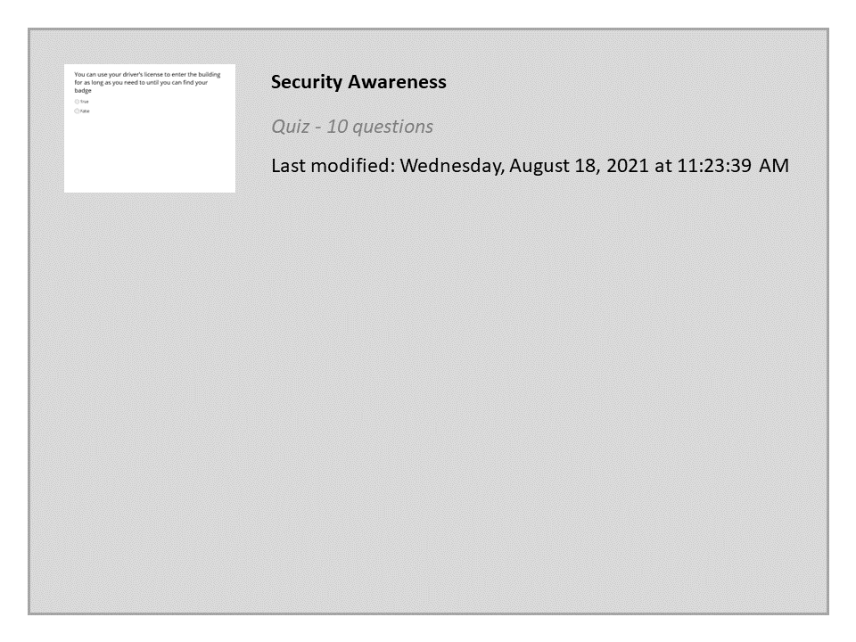


Properties
On passing, 'Finish' button: Close window
On failing, 'Finish' button: Goes to previous slide
Allow user to leave quiz: After user has completed quiz
User may view slides after quiz: Any time
Show quiz in menu as: Multiple Items
Edit in Quizmaker
Edit Properties

